Slide 1
Structural Differences of the Brazilian Stock Market
Shawn Leahy, Sary Levy-Carciente,
H. Eugene Stanley, Dror Y. Kenett

Slide 2
Outline
Purpose
Theoretical Perspective
Methodology
Similar Analyses
Brazil at a glance
Results
Conclusion

Slide 3
Purpose
Understanding the structure and dynamics of financial markets
We look at the effect of the market index on the correlations of its components and how they change over time
There are different types of markets with different types of connections and relationships so the results of one market do not necessarily hold for all
We use the Brazilian stock market as it has a better behavior before, during and after the most recent financial crisis
Can we find a way to distinguish stock market healthy growth from the formation of a bubble?

Slide 4
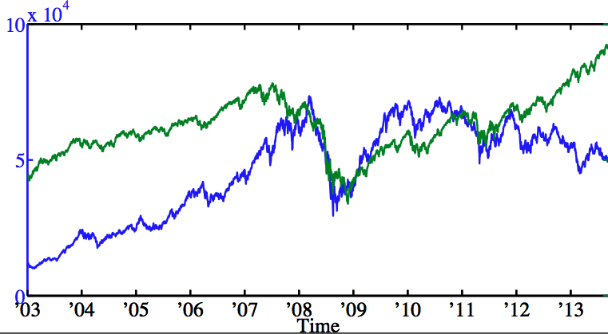
Theoretical Perspective
Brazilian Index Price and S&P 500 Price
S&P Price
IBOVESPA Price
Transform using:
r_{i}(t) = log P_{i} [ (t) ] − log P_{i} [ (t −1) ]

Slide 5
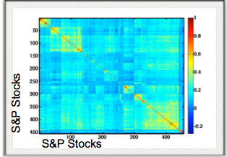
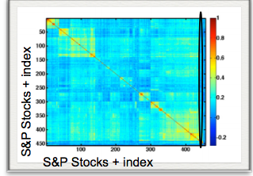
Stock Correlations
M
I J
C(i, j) =<(r(i) − < r (i)>)⋅ (r(j) − <r (j)>)>
σ_{i} ⋅σ _{j}
Without Index
With Index

Slide 6
Partial Correlations
The partial correlation (residual correlation) between i and j given a mediating variable m, is the correlation between i and j after removing their dependency on m; thus, it is a measure of the correlation between i and j after removing the affect of m on their correlation
M
I J
PC(i, j |m) = C(i, j) − C(i,m)⋅C(j,m)
√(1−C²( (i,m))⋅ (1− C²( (j,m))

Slide 7
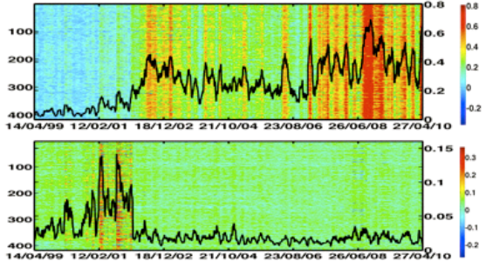
Similar Analyses
Correlations over time of S&P 500 stocks in U.S.
Correlations
Among stocks
Partial
Correlations
Excluding
The index
Dror Y. Kenett, Yoash Shapira, Asaf Madi, Sharron Bransburg-Zabary, Gitit Gur-Gershgoren, and Eshel Ben-Jacob (2011), Index cohesive force analysis reveals that the US market became prone to systemic collapses since 2002, PLoS ONE 6(4): e19378

Slide 8
Similar results have been found for other markets such as U.K., Germany, Japan, and India
U.K. Germany, and U.S. all track each other closely
Japan and India are not as uniform, but still follow time dependence
Kenett DY, Raddant M, Lux T, Ben-Jacob E (2012) Evolvement of Uniformity and Volatility in the Stressed Global Financial Village. PLoS ONE 7(2): e31144. doi:10.1371/journal.pone.0031144

Slide 9
Data for Brazilian Stock Market
29 Brazilian Stocks from 1/03 - 12/13
1 | ALL AMERICA LATINA LOGISTICA S.A.
2 | BCO BRASIL
3 | BRADESPAR
4 | BRF SA
5 | CCR SA
6 | CEMIG
7 | CPFL ENERGIA
8 | COPEL
9 | SOUZA CRUZ
10 | SID NACIONAL
11 | CYRELA REALT
12 | ELETROBRAS
13 | EMBRAER
14 | GERDAU
15 | GERDAU MET
16 | CIA HERING
17 | TAUSA
18 | ITAUUNIBANCO
19 | LOJAS AMERIC
20 | LIGHT S/A
21 | OI
22 | OI
23 | PETROBRAS
24 | ROSSI RESID
25 | SABESP
26 | SUZANO PAPEL
27 | USIMINAS
28 | VALE
29 | TELEF BRASIL

Slide 10
Methods For Analyses of Brazilian Stock Market
Adjusted stock daily closing prices → logarithmic returns
A short time window, of 22-trading days used
Correlations of all stocks and partial correlations between the stocks excluding the index
At each window we calculate stock correlation (partial) matrices, and average them to obtain a vector of correlations (partial)
Also we take another average of the correlations (partial) to obtain the overall market correlation for that window

Slide 11
Brazil at a Glance
Sao Paulo Stock Exchange Index (IBOVESPA)
8th-13th largest stock exchange in the world

Slide 12
Results
Correlations
Among stocks
Identical
Partial
Correlations
Excluding Index

Slide 13
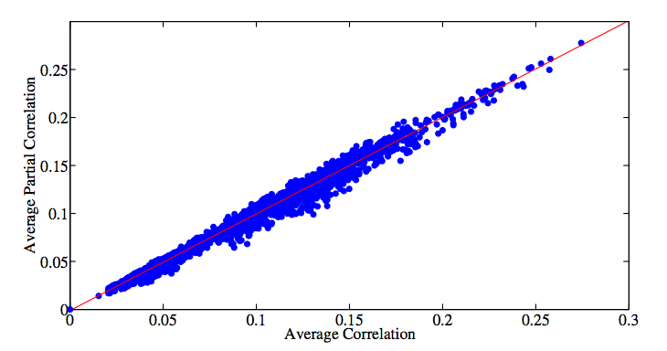
How similar are the two measures?
This market then cannot be said to be index driven, and the jump in correlations are not being pushed by feedback from the index.

Slide 14
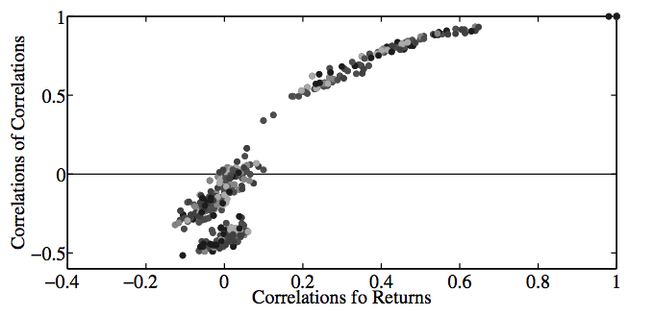
Before, During, and After Crisis
Correlation of stock correlations as a function of correlation of stock returns for pre-crisis period of 2003-2007 (top), crisis period of 2008-2009 (middle) and the post-crisis period of 2010-2013 (bottom).
Pre-Crisis
During Crisis
Post Crisis

Slide 15
What does the structure of a non-index driven market look like?
A hierarchical tree where the linkage to discern differences is the magnitude of the average correlations
Pre
Crisis
Finance
Utilities
Telecommunications
Construction/Basic Materials
Consumer
Capital Goods
Oil
Post
Crisis

Slide 16
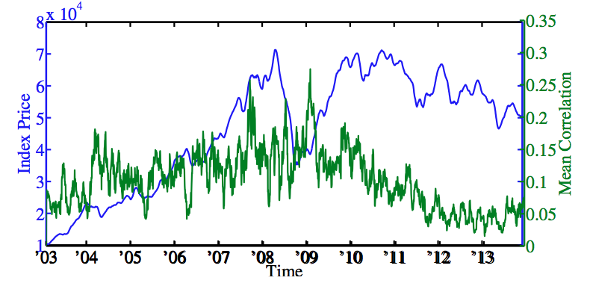
Interpretation
Not driven by the index, but due to an actual intra-stock correlations.
Market correlations and the daily closing price of the Index from 2003-2013

Slide 17
Conclusions
We have found differences in the structures and dynamics of the Brazilian Stock market compared to developed stock markets
The Brazilian stock market has shown to not be driven by its index
Could be reason for better behavior during and after crisis, we could be in presence of a possible measure as an early warning signal for the health of stock markets and distinguishing growth from bubbles

Slide 18
Further Research
There are many types of markets in the world
Much more work needs to be done to look at the structure of other emerging markets

Slide 19
End
Thank You!
Questions?

